Slide 1

Welcome to VRinVET! https://www.thinglink.com/card/1642196392619278339
VRinVET

Slide 2
PARTNERS
Keuda, Finland (coordinator)
TEC, DK
Fondazione Luigi Clerici, IT
Noorderpoort, NL
Somorrostro, ES

Slide 3
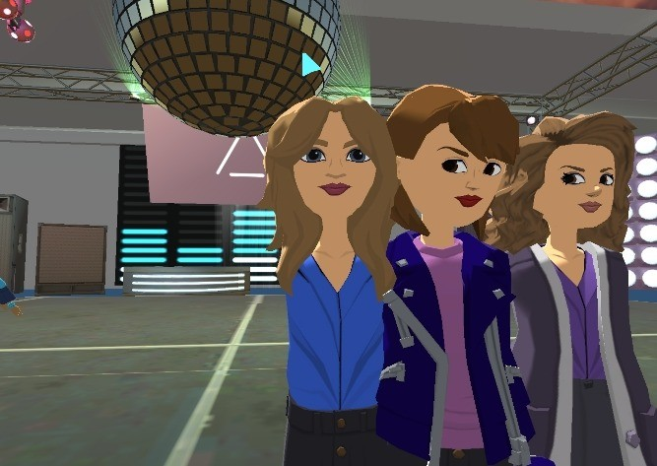
Meet, communicate and learn in a fun way!
Meet me at VROOM – a learning environment created in Microsoft Altspace
Learning environments in GLUE
Best practices on blended and distance learning
(accumulated during covid)
Available by the end of February 2023
Recommendations to teachers, IT support staff, management
www.vrinvet.eu

Slide 4
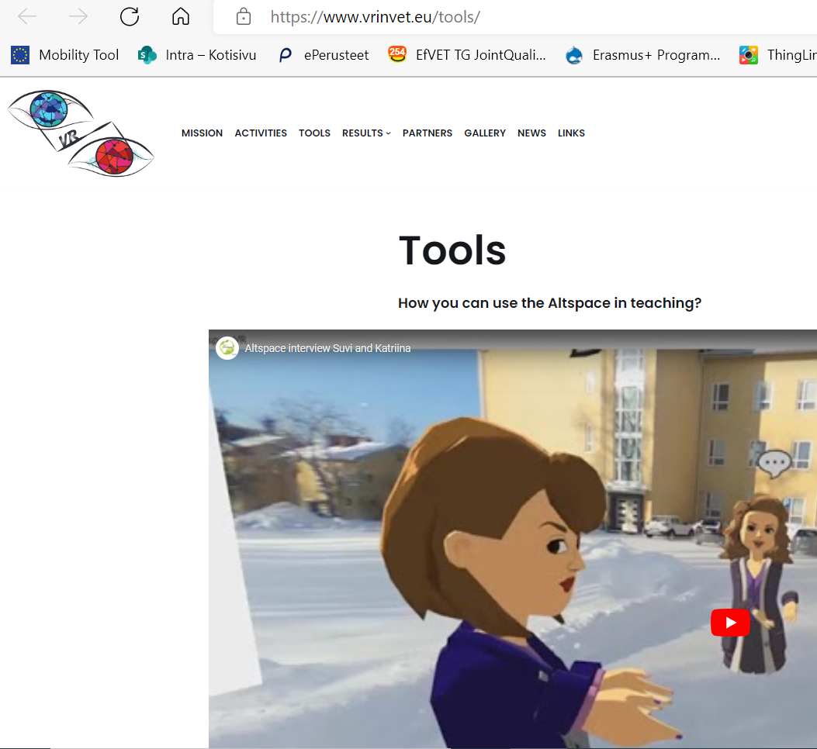
VROOM in Altspace
-> Microsoft Altspace - for free
-> Meet me at VROOM will be an international VR meeting and sharing point for vocational education and training
-> Learn digital skills in a VR environment with your students
-> communicate in foreign languages
-> visit a math labyrinth
-> visit virtually electricity wokshops
-> visit an escape room
->Tutorials how to start using Altspace at https://www.vrinvet.eu/tools/
-> Workshop how to start using Altspace: Keuda Finland 30.11. – 2.12.2022 (thinglink)

Slide 5
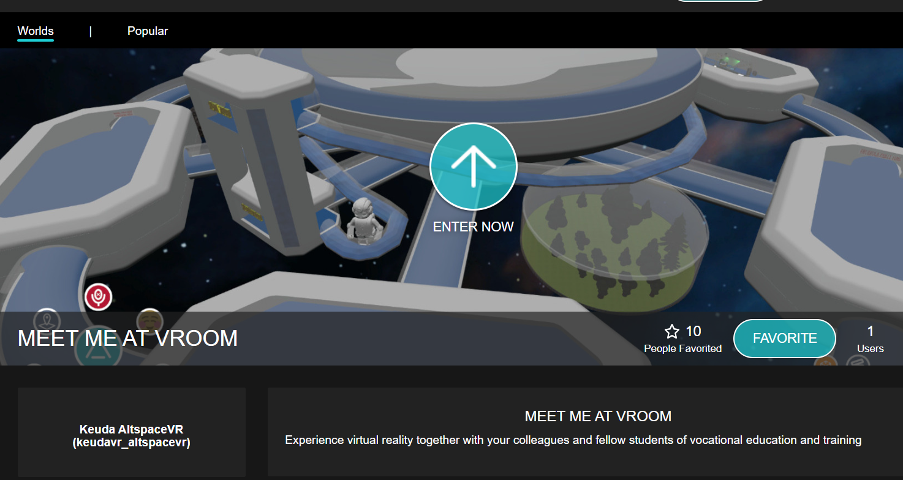
Screen shot of VROOM

Slide 6
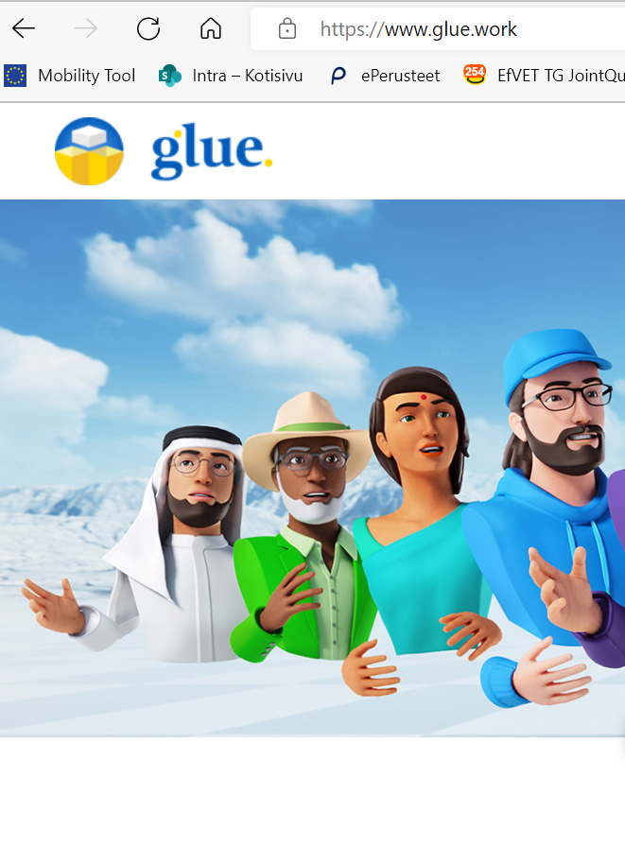
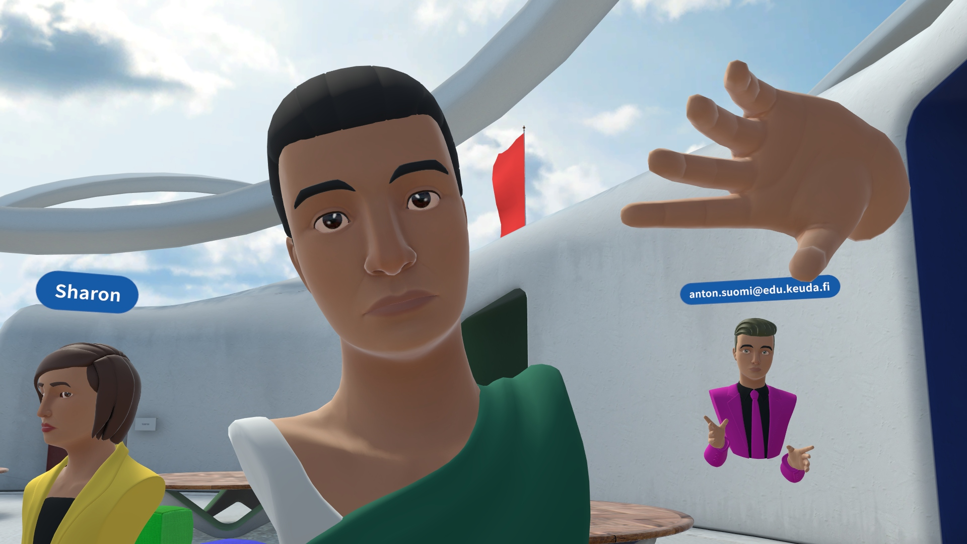
GLUE Glue - Virtual Collaboration Platform
A virtual collaboration platform
Operates with monthly licenses that float
Communication –team has planned regular meetings on Mondays with students

Slide 7
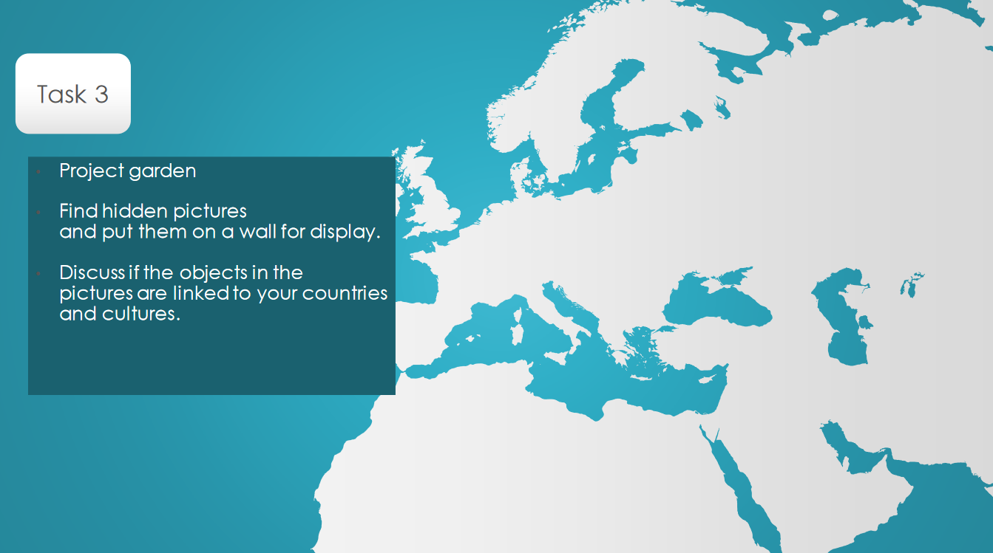
Example of tasks in GLUE

Slide 8
TEACHERS' EXPERIENCES so far
For organized sessions with several student groups:
30min in one go is enough
group size 2 students per teacher, all together max 8 students in one go
  Various reasons: internet –connection, audio echoing, physical rooms available, managing the physical situation
How to plan the teaching sessions in VR:
STEP 1: pre-arrangements
  Make sure that you have enough power supply (extendable cords) for the equipment
  Check that the Internet-connection works properly
  Book a room, privacy and ”audio peace” should be taken into account.
  Check that VR-glasses are charged
  Check that you know how the VR-glass log-in –account works. E.g. Ouculs Quest uses META –account or Oculus account
  Log in to the VR-environment alone or with co-teachers to see that all is working properly
STEP 2: 1st time with students show them the basics: how to log in, how to move and speak, getting to know the place.
STEP 3: 2nd time with students, start with assignments. It is good to have a back-up communication channel, e.g. whatsapp or TEAMS, open with your colleagues.

Slide 9
TEACHERS' EXPERIENCES so far
Studies in communication and interaction in English
Synchronous and asynchronous assignments in Glue
Aim to offer students a platfom to meet and speak in English in VR, to learn to navigate in VR and to gain experiences of online communication
Students preferred sharing in VR, e.g. presenting and getting to know schools and studies
Students used pictures and videos to support their presentations

Slide 10
STUDENT’S EXPERIENCES so far
Some felt insecure speaking even thoug they had experience of videogames
Some felt it easier to communicate in vr than face to face
Some students felt connected
Co-creating! Students started to brainstorm tasks that could be done in VR

Slide 11
TECHNICAL ASPECTS: INTERNET CONNECTION
AltspaceVR – minimum requirement 5mbps -> Link to the information souce in EN
Oculus Quest VR-glasses2 – HD resolution 80-100mbps -> link to information source
For sake of comparison:
  Teams-videocalls (withouth sharing the screen)
  one to one, resolution 1080p - 1,5 mbps
  group call, resolution smaller - 1 mbps
  link to information source
If your school does not have a good enough Internet connection, you may
share your 5G or possible school’s 5G mobile phone connection directly from your phone via WLAN or via USB

Slide 12
TECHNICAL ASPECTS: EQUIPMENT
The surface, i.e. the touch-screen pad, doesn’t run Altspace quick enough. Laptops work just fine. Recommendation: use laptops until you get a faster web where surface works OK.
Headphones with microphone -> In Altspace, the sound may be circulate without headphones, even though it works without headphones. Basic headphones with microphone with wire should work OK.
Oculus Quest VR –glass batteries -> you may use the external recharchable powerbank available for phones, to avoid running out of battery. Normally the battery should keep for ca 2 hours, however, sometimes the VR-glasses are not fully charged when you start using them.
Your phone battery is not good enough to share net -> remember to bring the charger or use the external powerbank
Students are not allowed to install AltSpace on their computer (in Finland, laptops are provided by the VET-school) -> ask help from IT to install the program from Microsoft Store.

Slide 13
SUPPORT ISSUES
You need help from
Management – getting some equipment and time resources, later on possibly licenses to commercial VR-platforms like GLUE or WONDA
It/digi -support – helping you to set it up, run it and develop it (Internetconnections, downloading onto laptops, keeping in store the VR-glasses?)
Think of this as well
Where do you store the equipment and how do you share them with your colleagues?
Buy a 360-camera (ca 200€) to make 360-photos and bring them into Altspace – a nice way to show your surroundings to others!

Slide 14
FINALLY: WHY WE DO IT (ANYWAY)?
Students love it as an alternative way of learning
Shy students can benefit from possibility to communicate from behind of an Avatar -> can be a great benefit!
Experimenting with new technology is part of learning digi-skills for both students and staff
VR offer many, many various kinds of learning environments

Slide 15
LINKS
Altspace is free of charge. It is a global, social VR-environment
GLUE can be used 30min for free, otherwise monthly floating licenses
Katriina and Suvi are in Altspace, explaining what you can do there (video ca 13min) https://youtu.be/MRbdQ_1I-Ck
Keuda presents ”How we utilize virtual environments and technologies” (video ca 19 min) XR Keuda - YouTube

